Slide 1
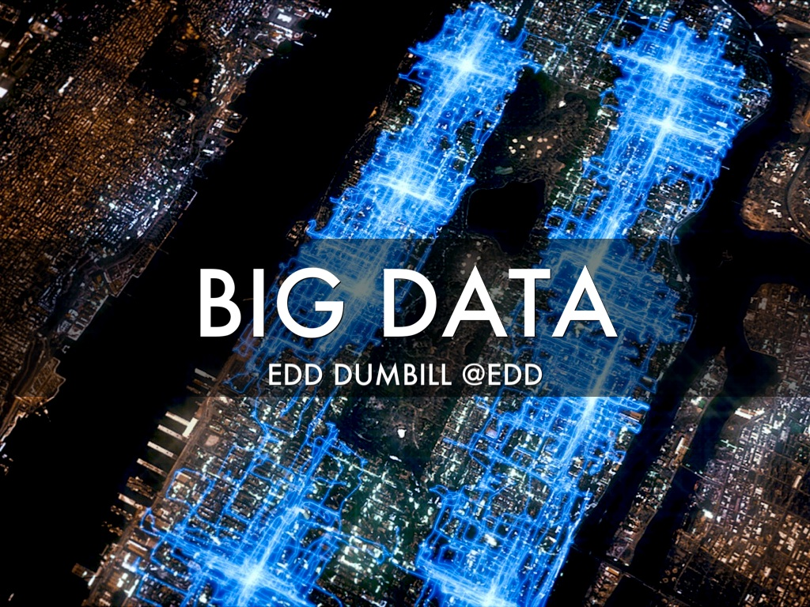
Notes:
The cover image shows routes taken by Domino's pizza delivery bikes in Manhattan
Explain a bit about who you are.

Slide 2
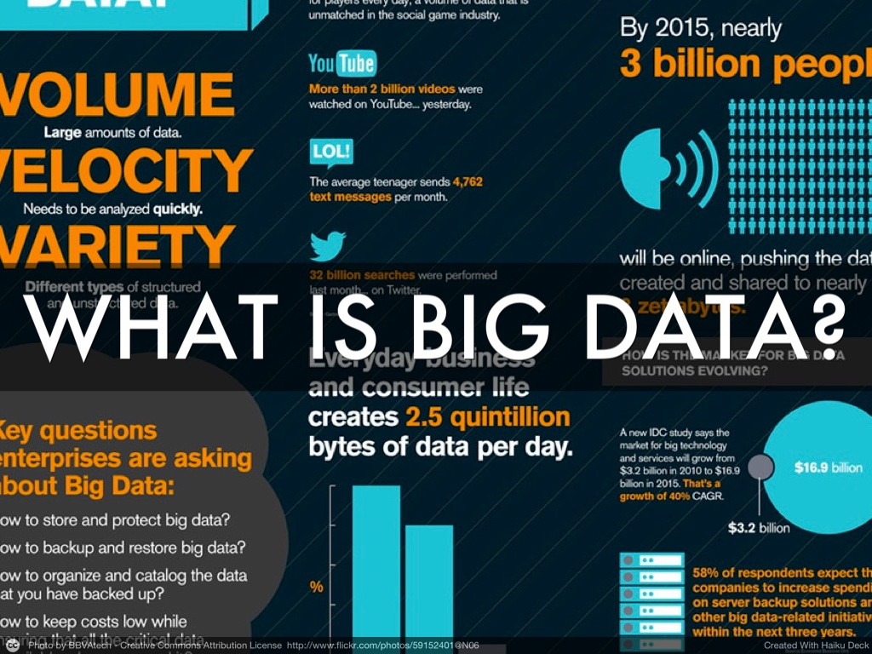
Notes:
Hard to have avoided the news about big data in the last year.
A lot of different definitions, depending on which lens you look through: from social media, through big brother, to the IT world.
My definition "smart data".

Slide 3
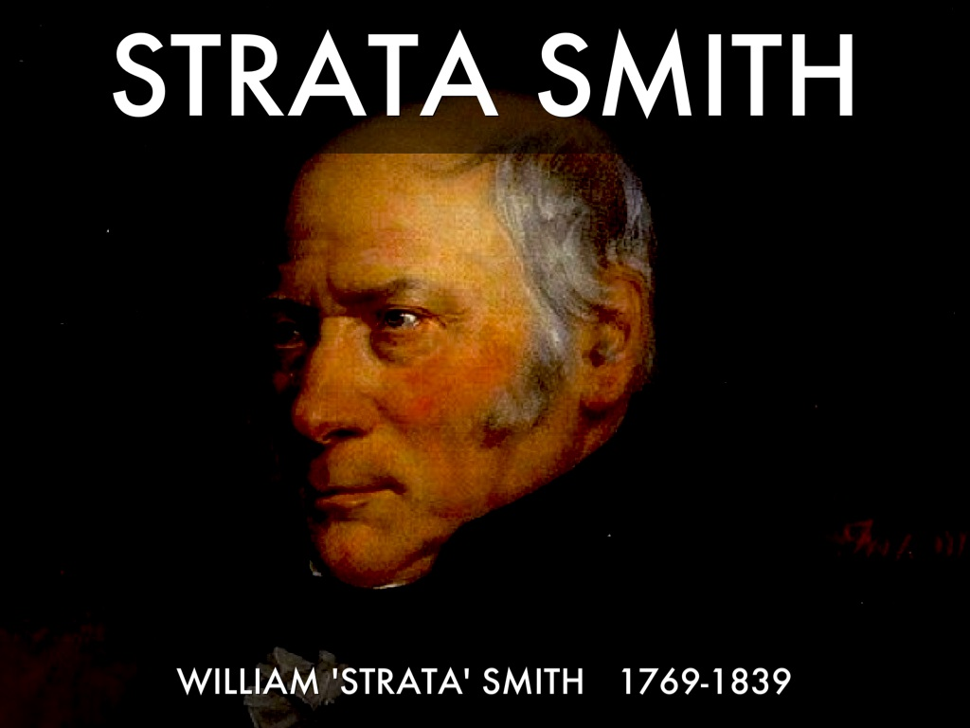
Notes:
William "Strata" Smith was an English geologist who lived over 150 years ago.
He noticed by examining out crops of rock that the fossils always appeared in the same order.
He was then able to deduce from the rocks on the ground, what lay underneath.

Slide 4
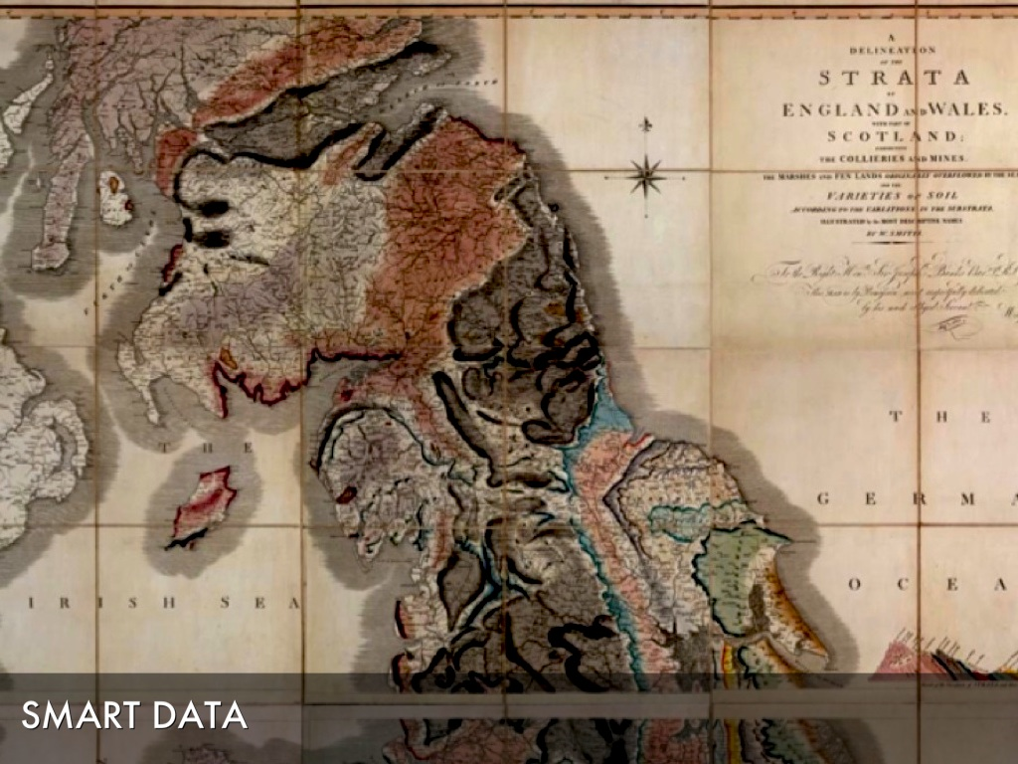
Notes:
Smith produced a geological map of the UK, showing the location of minerals, which made a lot of people very rich.
This is a great example of smart use of data: using observations to create interferences and hence new value.

Slide 5
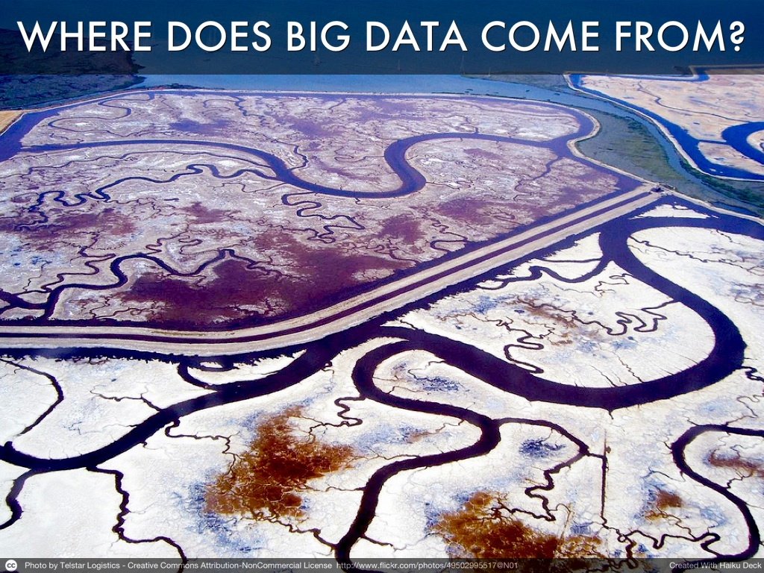
Notes:
Until a few years ago, the role of IT in an organization was mostly automating processes that had previously been done with paper.
Other phases of the product loop: customer interaction, sales, manufacture, all happened very much within the physical world.
Companies today are becoming increasingly digital as ever more comes under algorithmic control. Not just customer interaction, but even manufacture and delivery.
Big data is in essence the signal pulsing through this new digital nervous system.

Slide 6

Notes:
Quite naturally, big data originates with those organizations who have a lot of data to generate. It's unsurprising that web companies have a big role in its genesis.
Google pioneered the use of cheap commodity computers to crunch data. Using a technique they called "Map Reduce" they were able to spread large computations out over very many computers at once. In this way they were able to compile the search index that powers their search engine.
Facebook perform many computations per user to deliver their personalized recommendations and adverts.

Slide 7
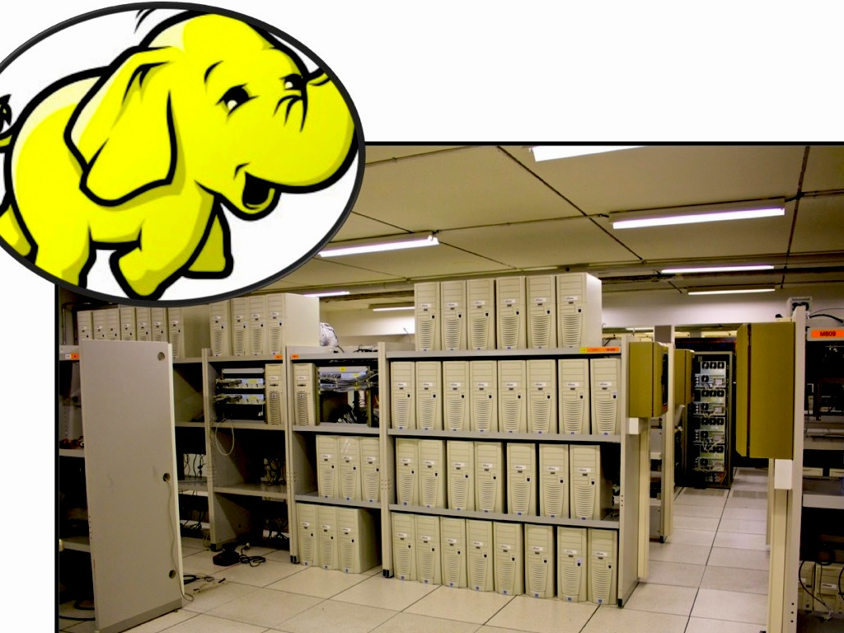
Notes:
Wal*Mart were already doing it. So what’s the big deal?
In some IT circles, Hadoop is synonymous with big data.
Symbolized by the toy elephant of its creators' son, Hadoop emerged from Yahoo! as an open source implementation of Google's Map Reduce paper.
Making this power available to more or less anybody at low cost has driven much of the revolution in big data we are experiencing today.
It happens against another important computing change—the cloud—with just a credit card, anybody can get started crunching big data sets today.

Slide 8
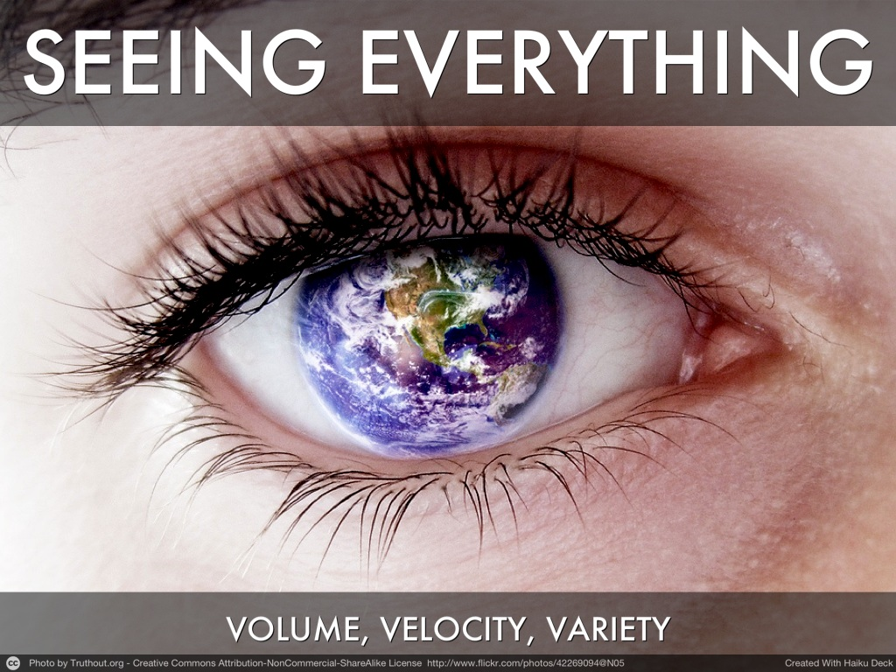
Notes:
The IT industry explains big data often in terms of variation in three "Vs".
Volume: a larger amount of data than conventional systems can process.
Velocity: faster changing and arriving data.
Variety: unstructured data and multiple data sources. Traditional data warehousing & analytics only know square data!
But the supreme change big data has brought is the ability to examine every single data point in a population.
High level example: mail order catalogs vs Amazon recommendations.
No sampling needed: sampling is fraught with trouble, you're deciding ahead of time what's representative data, you can't zoom in, restricts axes of exploration.

Slide 9
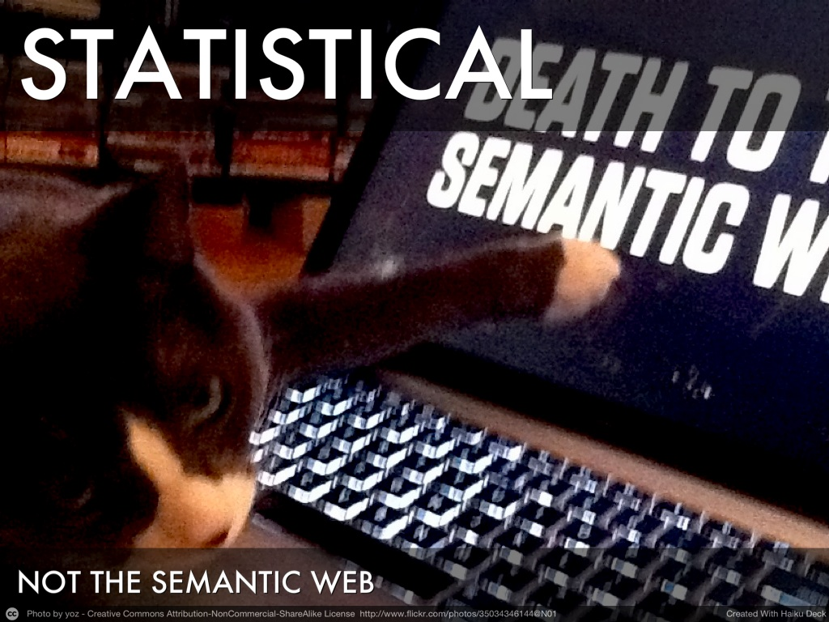
Notes:
Statistics and sampling isn't the only practice that big data is disruptive to: semantics comes in for a challenge too.
Consider the original battle of the web: Yahoo! as a curated guide vs Google's statistical approach. The data got too large and complicated for Yahoo!'s directory.
Ontologies are problematic (Norvig et al in "The Unreasonable Effectiveness of Data")
* Ontology writing: hard, and the easy ones are done.
* Difficulty of implementation: hard to get people to encode metadata.
* Competition: people want to promote their own ontology for competitive reasons.
* Inaccuracy and deception: trust problems at large.
So, reverse the model. Instead of classifying each instance, find the natural categories and label them.

Slide 10
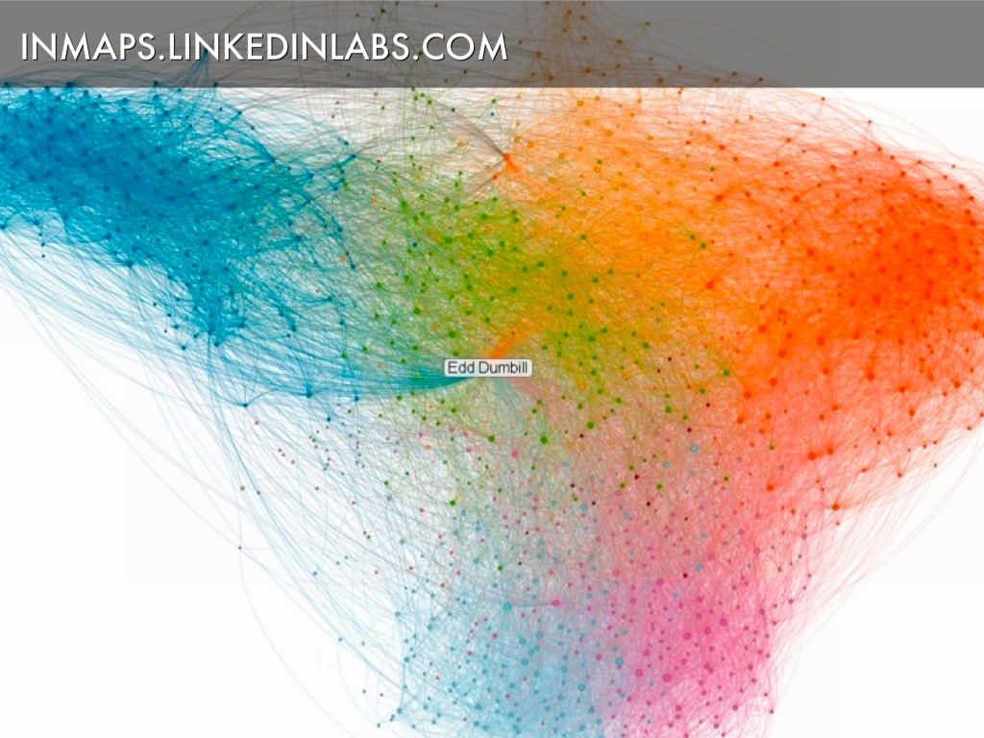
Notes:
Great example of the statistical approach.
Clustering algorithm applied to your contacts and their interrelations.
Very capable of finding communities of which it had no explicit knowledge.
The graph shows my professional network: dark blue is the XML community, for example, and red is O'Reilly Media.
(example too: Enron email interactions)
http://inmaps.linkedinlabs.com/

Slide 11
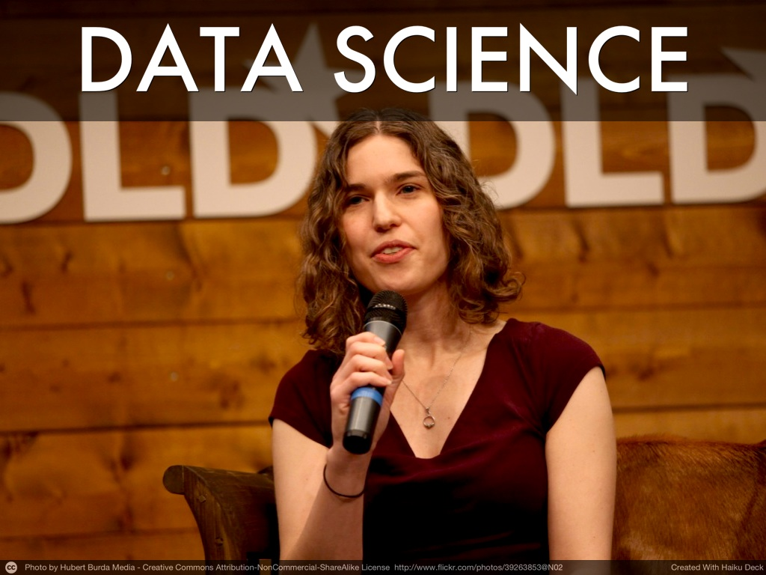
Notes:
The arrival of big data and the importance of data as a product heralded what's been touted as the hottest job of the decade, "data scientist".
Combination of statistician, programmer, entrepreneur and storyteller. DJ Patil in "Building Data Science Teams" (http://radar.oreilly.com/2011/09/building-data-science-teams.html) characterizes their role in companies:
* Decision science and business intelligence
* Product and marketing analytics
* Fraud, abuse, risk & security
* Data services and operations
* Data engineering and infrastructure
Patil characterizes a data scientist as having:
• Technical expertise: the best data scientists typically have deep expertise in some scientific
discipline.
• Curiosity: a desire to go beneath the surface and discover and distill a problem down into a very clear set of hypotheses that can be tested.
• Storytelling: the ability to use data to tell a story and to be able to com- municate it effectively.
• Cleverness: the ability to look at a problem in different, creative ways.
In essence, the change is this: you can't put analysis in a box. A large BI vendor told me that their biggest problem tended to be the organizational structure of their customers, analysts were isolated in their department, throwing reports over the wall.
Google, Facebook et al not only have better tools, but they are organized around the importance of data to their organizations. Reaping benefit from data may well be as simple as sitting your analyst next to the business team.

Slide 12
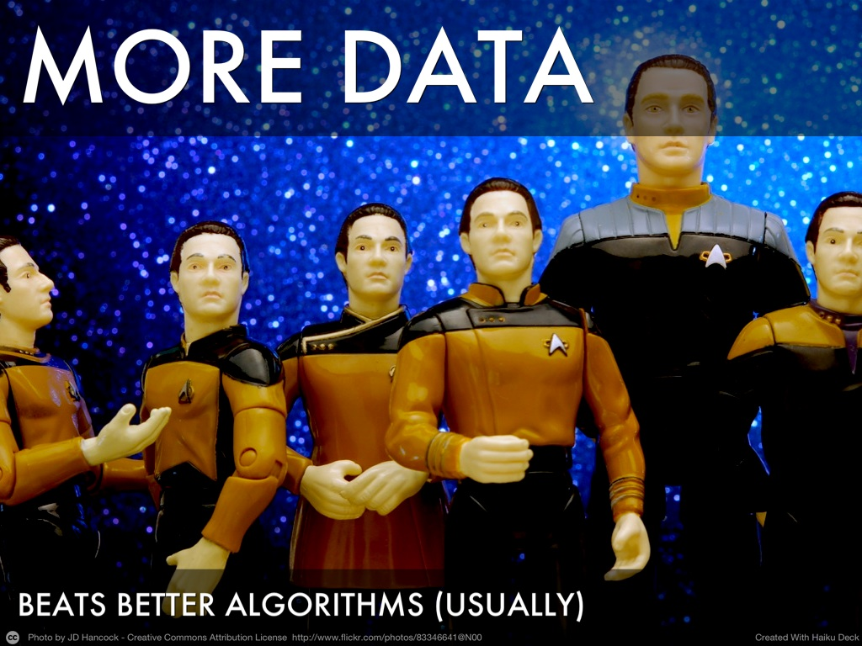
Notes:
A few principles of big data.
I mentioned earlier that the key change in big data is being able to analyze all the data points. When you do that, you find that astonishingly simple algorithms can often suffice.
Also, adding in external data sources can radically improve your analysis. Here's one example:
Anand Rajaraman of Walmart Labs
http://anand.typepad.com/datawocky/2008/03/more-data-usual.html
"Different student teams in my class adopted different approaches to the problem, using both published algorithms and novel ideas. Of these, the results from two of the teams illustrate a broader point. Team A came up with a very sophisticated algorithm using the
Netflix data. Team B used a very simple algorithm, but they added in additional data beyond the Netflix set: information about movie genres from the Internet Movie Database (IMDB). Guess which team did better?"
The best algorithm using samples is beaten out by techniques that work at the level of N=all
ComScore vs Efficient Frontier (2008)
http://anand.typepad.com/datawocky/2008/04/more-data-beats.html
In marketing, one particularly "magic" data set is location. Consider sales figures from retail stores, combined with the average drive time to a competitor store.
Adding in these multiple data sets is hard work and today's tools are only starting to make that easier.

Slide 13

Notes:
When people say "big data is the new oil", this is what they're talking about: the sometimes surprising propensity for large humdrum data sets to contain immense business value when processed.
In a digital world, our every action leaves traces. For example, financial traders try and obscure their searches on information systems so as not to leak their intent.
Shwetak Patel story, analyzing energy signals. Knowing what you’re doing can inform action.
Google using the search logs to understand users' behavior, and find signals that can be used to improve the product. This is how Steven Levy describes it:
'But the information Google began gathering was far more voluminous, and the company received it for free. Google came to see that instant feedback as the basis of an artificial intelligence learning mechanism. ... On the most basic level, Google could see how satisfied users were. To paraphrase Tolstoy, happy users were all the same. The best sign of their happiness was the “long click”— this occurred when someone went to a search result, ideally the top one, and did not return. That meant Google had successfully fulfilled the query. But unhappy users were unhappy in their own ways. Most telling were the “short clicks” where a user followed a link and immediately returned to try again.'
Levy, Steven (2011-04-12). In The Plex (p. 47). Simon & Schuster, Inc.
Best place to look for improvements is by observing user behavior. This is where observation beats out theory again.
It's a benign feedback loop that offers a competitive advantage. The more people use your product, the better it gets.

Slide 14
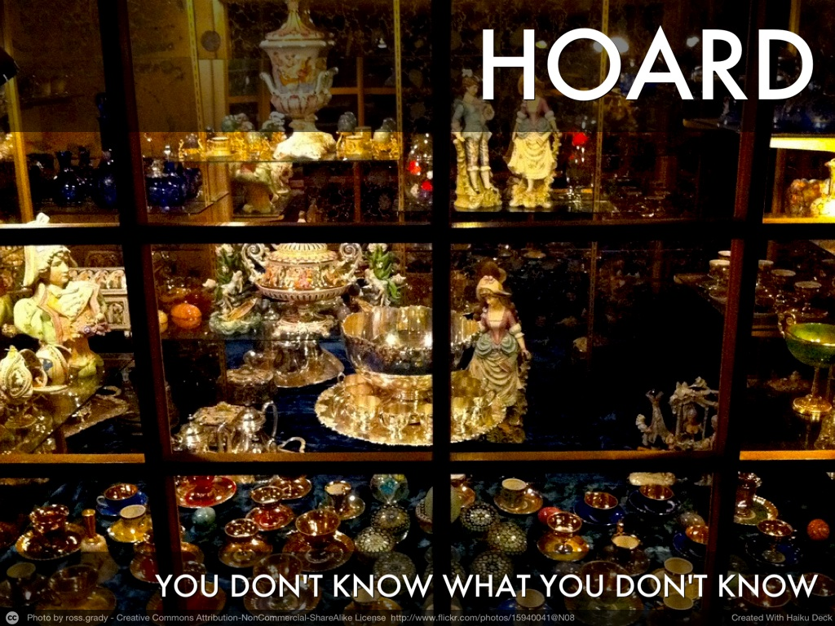
Notes:
When data storage is limited, storing every piece of information is troublesome.
This is how many of today's data warehousing solutions work. Data is loaded into the warehouse, transformed and cleaned into a schema most appropriate for purpose. Anything you throw away is lost. That might be invalid data, or detail that's not needed for current business purposes.
With big data, the approach is opposite. The idea is to store all raw incoming data. Because large amounts of data can be processed rapidly in parallel, there's no need to clean it up and transform it in advance, you can do it "just in time".
Because no information is lost, you can go back and look at data through a different lens, and find value you didn't know you needed the first time around.
Give example of line items in shopping, for example. Or that of errors: nulls can be meaningful.
This is set to be a sea change in how business handles data. Instead of 3 month turnarounds for small changes to reports, expect a self-serve infrastructure that encourages exploration and questioning.

Slide 15
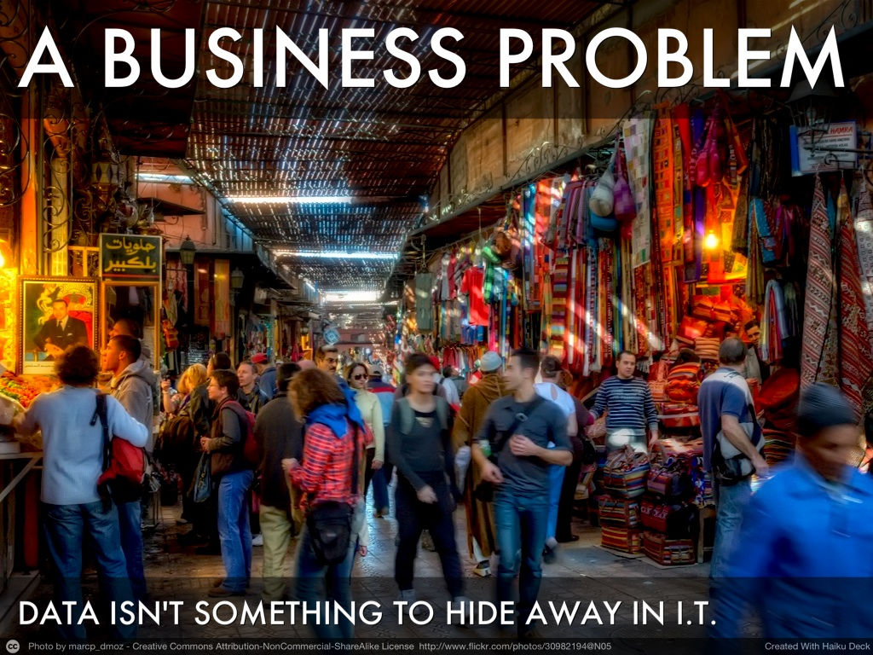
Notes:
"Business Problem" is jargon that means everybody should care about data and what it says. We don't ignore what we smell or see, and in the new digital era, data is feeding us those senses.
Blind organizations can walk on unawares for a while, but then their mental maps start to fail them.
Realistically, what does this mean?
* Buy in for using data must exist at the top level
Don't separate people who understand the domain from those who understand math, combined them and mix them up!
There be dragons: understanding bias and models. (Race as a proxy, for example. Consider the LinkedIn graph.)
* Be prepared for organizational change to happen if you really want to use data well
Big data is developing against a background of change in IT. No longer is savvy IT about central planning, but about enablement.
* Data should be made available to all who want to use it. A successful example in the large is that of opening government data, and resulting ecosystems of private companies providing value through the data.

Slide 16
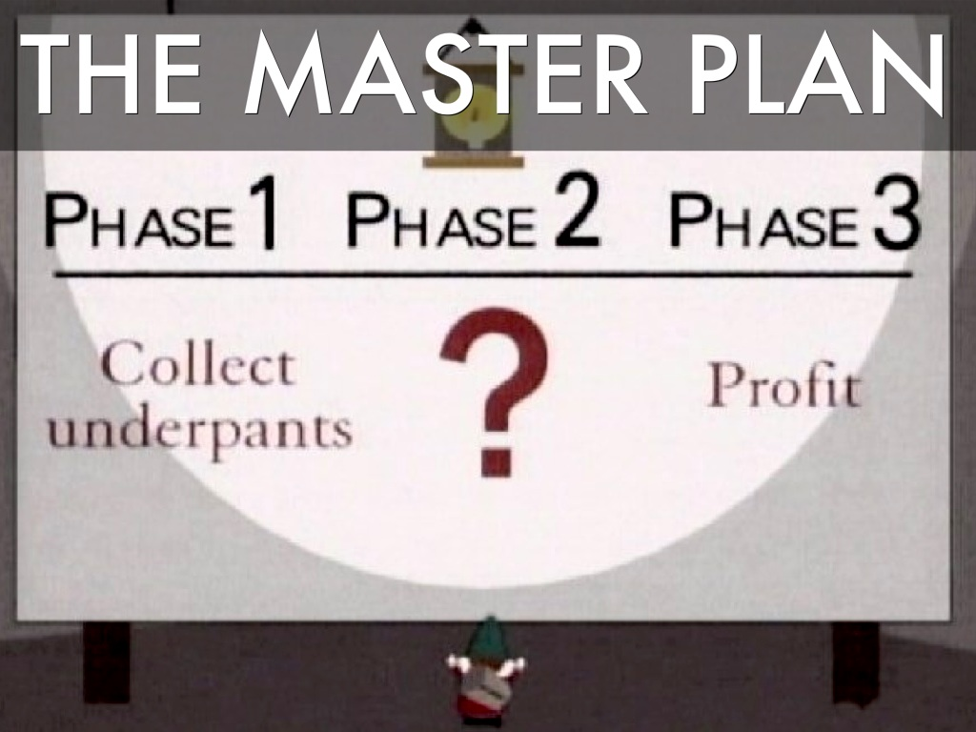
Notes:
We're mostly at phase 1: "get the data"
This turns out to be spectacularly difficult, and it's where most of the current industry effort is focused. Data marketplaces were a big deal a few years ago, but didn't take off. Why? There was nowhere for the data to go.
Inside an organization, getting access to data can often run up against politics and silos.
We're starting to push into phase 2, and understand some of the patterns of change. Training up data scientists, building out data platforms inside organizations, creating easier services and tools.
There's not going to be a one-size-fits-all Phase 2. Instead, the thing to do is to figure out your target problem, and then working with the data to answer it.

Slide 17
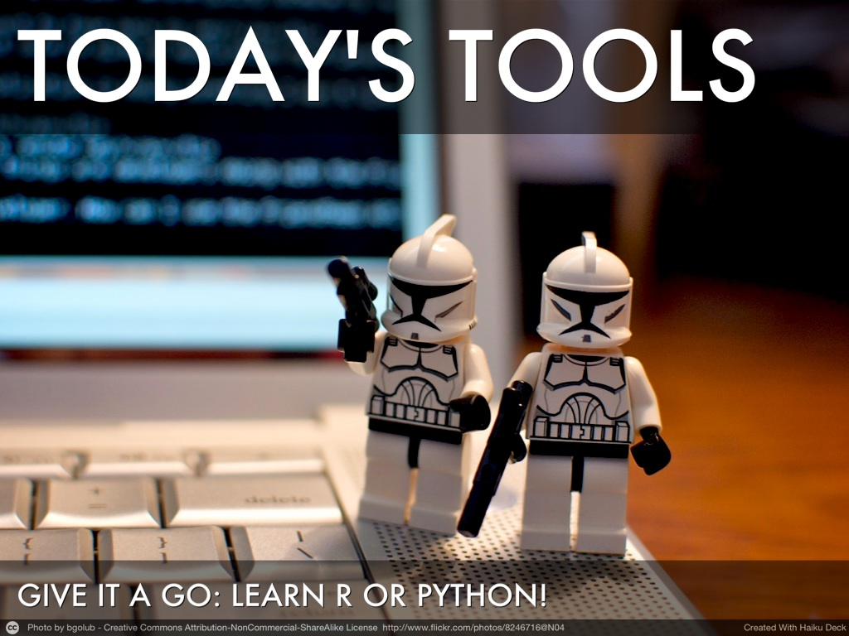
Notes:
Firstly, to get into "big data" you don't have to work on big data. Smart use of data is the most important thing to get familiar with.
You can work on small data sets with R, Python, Gephi. If you don't know relational databases, learn them, as SQL isn't going away any time soon. Learn all the things you need to liberate data. Google Fusion Tables. Look at the Guardian's data blog and learn from what they do.
Tinker.
Hadoop is an operating system for big data. You can get started working with it using reasonably familiar tools and Amazon's cloud services. State of tooling is still immature, you need to be a programmer.

Slide 18
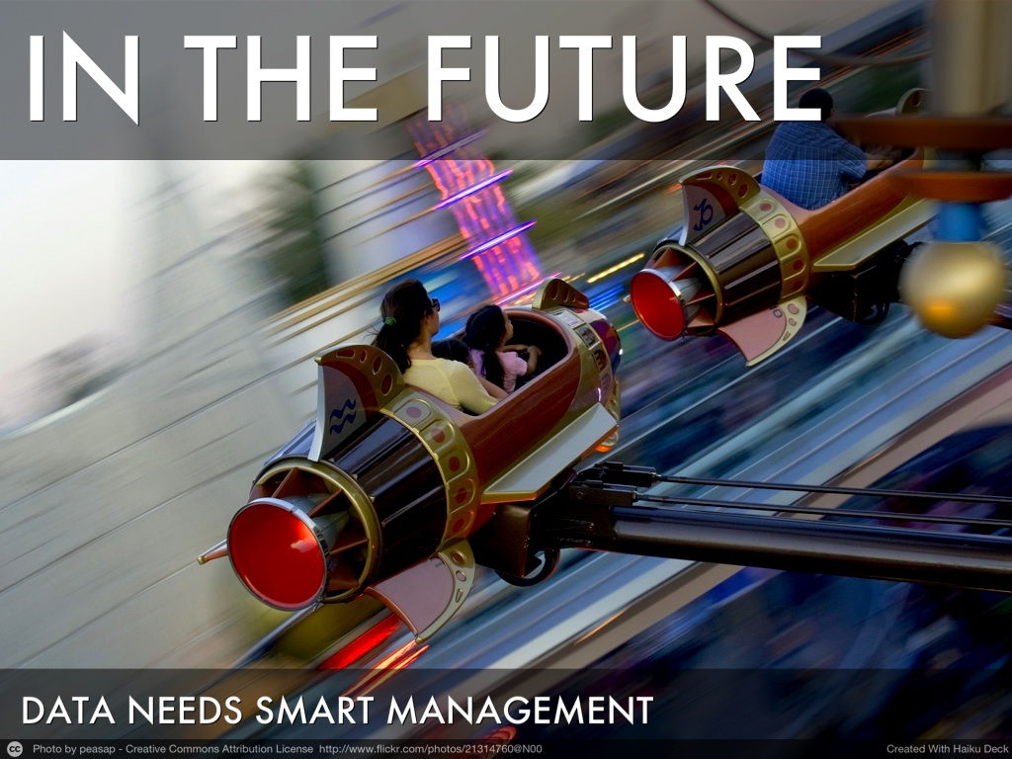
Notes:
As we're busy reinventing our data infrastructure at scale, there are plenty of concepts from the "small data" world that don't exist yet for big data: and will become correspondingly more vital.
* Provenance: where did this data come from?
* Indexing and location: where can I find the data?
* Dependencies: which systems depend on this data for their function?
* Auditing: who has touched this data, how was it transformed?
I don't expect the solutions to these problems to be exactly the same as today's for smaller data. A change in scale can bring a change in nature too.

Slide 19
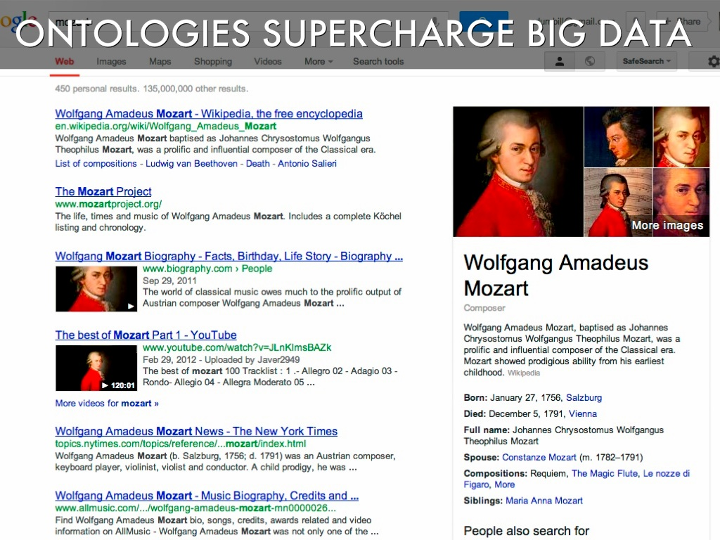
Notes:
All is by no means lost for the ontology.
Big data actually gives the semantic web something to do. One of the biggest problems in data management is classifying it: big data allows us to do a lot of that automatically. We can now start to deploy systems in a smart way based on ontologies.
Even Google have realized this, and they're making a huge push with their "knowledge graph".
The stage is set for applying artificial intelligence to enable computers to help people radically more than they ever could before.

Slide 20

Notes:
As more of the world can be measured, your organization becomes more like a laboratory.
The things that make a good scientist and a good leader in real life apply in data too.
Above all, ask good questions

Slide 21
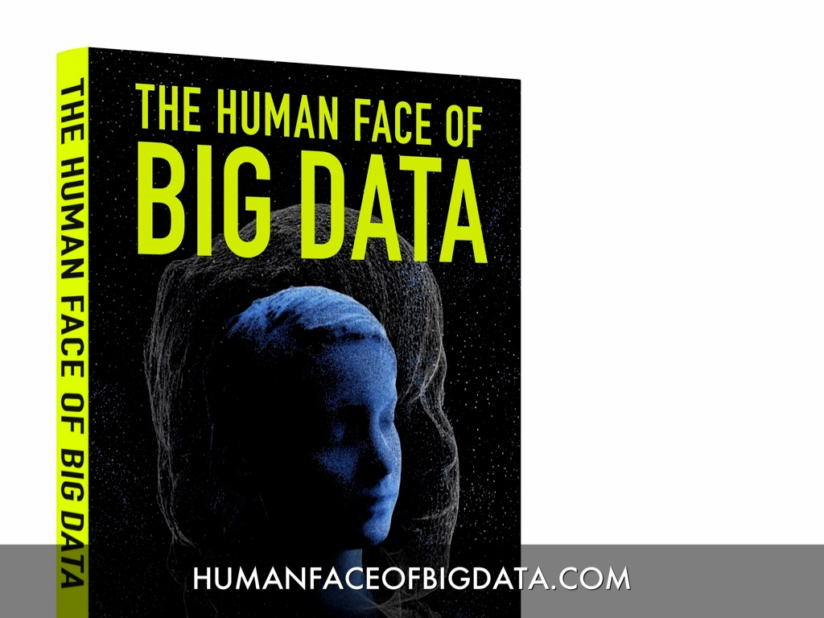
Notes:
Excellent photographic storytelling about how data and analytics touch our everyday lives.

Slide 22
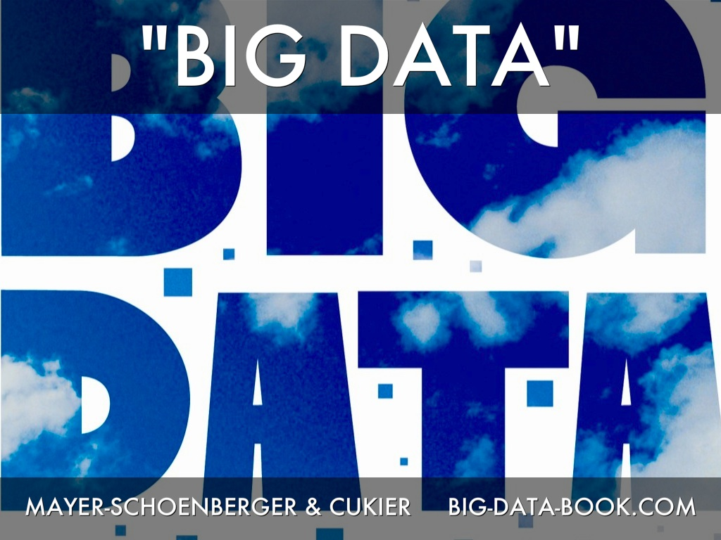
Notes:
http://big-data-book.com/
by Viktor Mayer-Schönberger and Kenneth Cukier, who wrote the influential Economist report on big data in 2011.
A wonderfully written trove of stories that illustrate well the principles of big data.

Slide 23
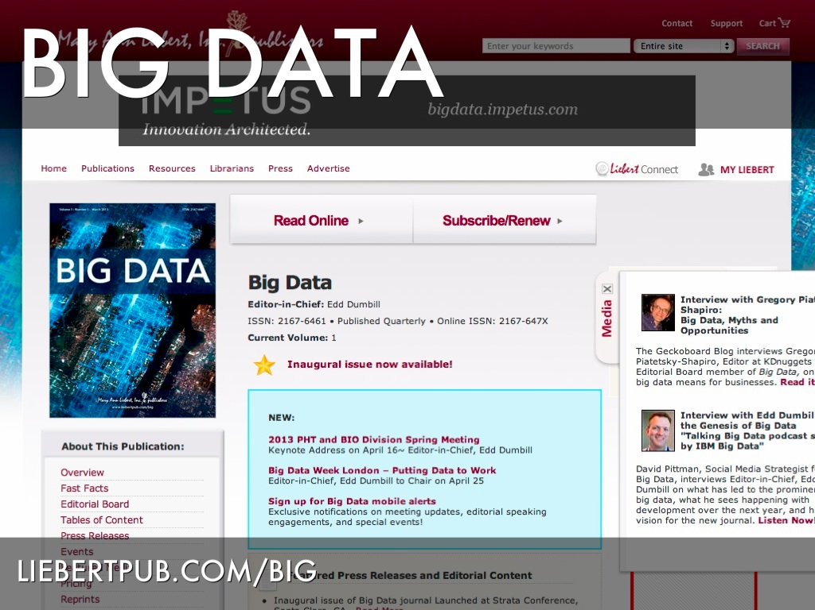
Notes:
I'm the Editor-in-Chief.
Our aim is to be integrative across disciplines and foster discussion of interest over the data-using community.

Slide 24
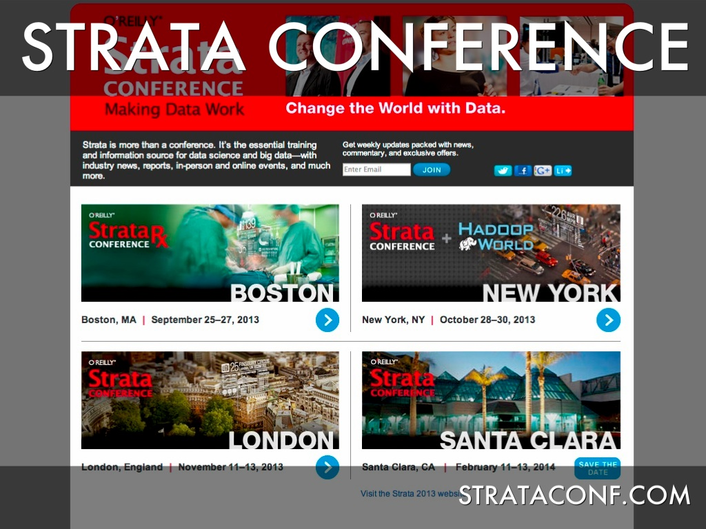
Notes:
I'm the founding program chair for this conference, which now happens four times a year. http://strataconf.com/
Our tagline is "making data work", which sums up my philosophy to this area.

Slide 25

Notes:
I also run the "Data Data Data" community on Google Plus, which is a good place to learn of new tools and join in high-signal discussions around big data and data science.
Closing thoughts: as managers of information, we’re in a great place to fuel the transformation around data, to take it from being an assistive role to the genesis of new value in our organizations.

