Slide 1

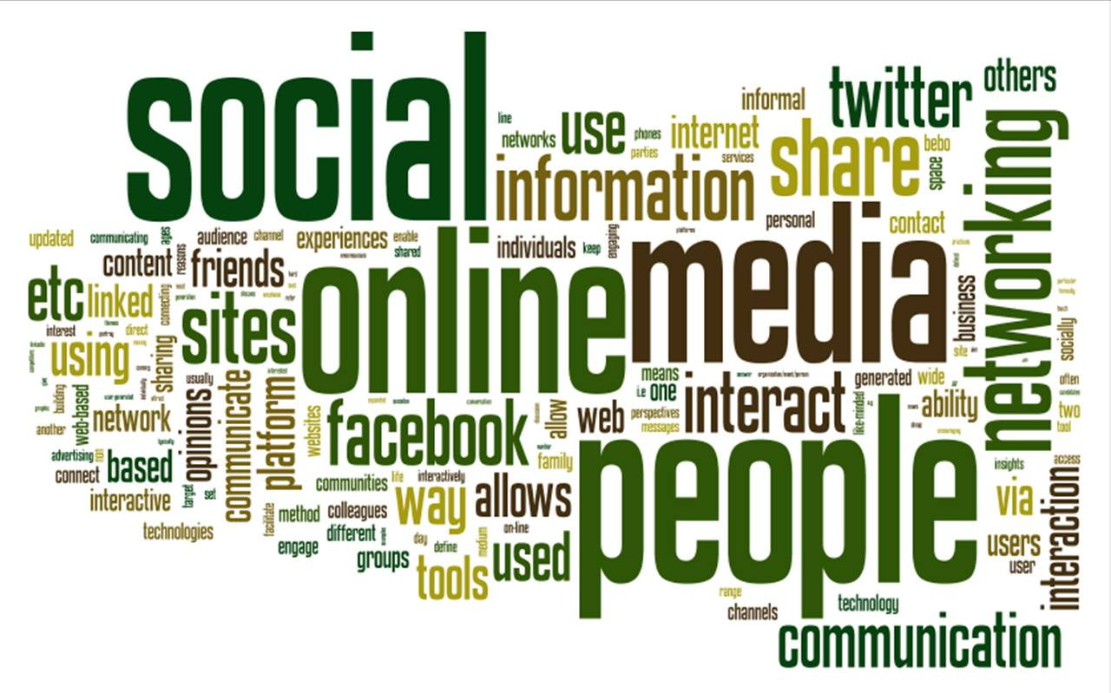
Making Social Media
a Competitive Asset

Slide 2
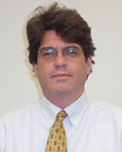
Presented By
Ed Silverman
Editor, Pharmalot
Editor-at-Large, Med Ad News
Ed.Silverman@ubm.com
www.Pharmalot.com
@pharmalot facebook.com/mypharmalot Pharmalot
@edsilverman

Slide 3
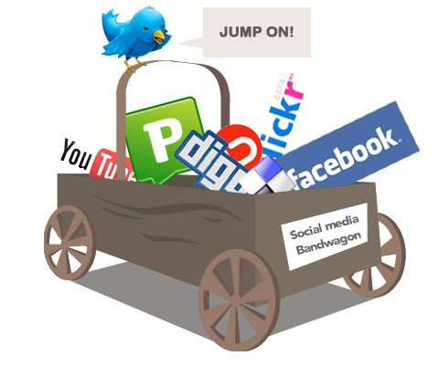
A Roundtable Discussion about Social Media and Information Gathering
Why social media is important
What data sources can be used?
What potential business use does this information serve?
What mechanisms for searching this data do we have?
Finding the right fit: pharmacovigilance, business intelligence

Slide 4

Ed Silverman
Editor, Pharmalot
Editor-at-Large, Med Ad News
Ed.Silverman@ubm.com
www.Pharmalot.com
@pharmalot facebook.com/mypharmalot Pharmalot
@edsilverman

