Slide 1
The Global Information Manager: Creating Strategic Value
Deborah Hunt, SLA President
and Principal, Information Edge
April 15, 2013
Notes:
Good morning dear colleagues. Before I launch into my presentation, I’d first like to give a round of congratulations to the Division for receiving the “Unit Ingenuity & Innovation Award.” The award was presented at the Leadership Summit in Dallas in recognition of the PHT Division’s 2012 contributions to SLA in strategic and innovative programming and member engagement, as exemplified by the Winter Virtual Conference. The PHT Division also received recognition during the Unit Success Stories Mutual Support/Multi-unit Collaborations Section for its BIO/PHT spring meeting collaboration.
Alex Feng, 2012 Divison Chair, was not there to receive it, but I’d like to recognize him and those who worked on both of these initiatives.

Slide 2

The Emerging Role of the Global Information Professional
Who are we?
Where do we want to go?
How will we get there?

Slide 3
Who are we?
“…we librarians or information professionals definitely aren’t what we once were. If we play our KM (knowledge management) or ‘knowledge engineer’ cards right, there are very few areas in any organization in which we won’t have significant contributions to make.”
“Education for Changing Roles” by Ulla de Stricker. Information Outlook, Oct/Nov 2009, p. 21.
Notes:
This is where we become invaluable as we shed or expand old roles and become part of the solution, not perceived as part of the overhead.

Slide 4

Do I look like a librarian?
What’s in a name?
Who are we?
What do we want to be called?
Does it matter?
.
Notes:
SWA story
Does it matter? How would you answer these questions?

Slide 5
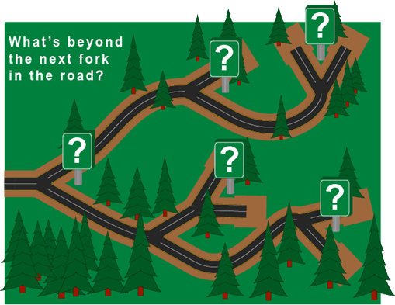
Where are we going as information professionals/librarians?
Notes:
We need to know this and practice this if we are to control where we are going and how we’ll get there.

Slide 6

How will we get there?
Be proactive
Take risks
Get education
Invest in yourself
Notes:
Are we going to sit back and wait for opportunities or are we going to do something about it?
We have to be proactive, taking control of our work and our profession.
We may feel powerless to overcome some trends, but if we give up, we are sure to fail.

Slide 7
“LIS skills are good currency, but only for those with the flexibility and insight to exploit the opportunities. “
Stephen Abram, Dysart & Jones
Notes:
LIS = Library and information science
As Stephen Abram noted (I’m paraphrasing here): “LIS (library and information science) skills are good currency, but only for those with the flexibility and insight to exploit the opportunities.

Slide 8

How do we transform ourselves, our jobs and the places we work?
Notes:
What are the trends that are happening that impact us and that must drive what we do and how we work?
Our value to our organizations must be continually demonstrated and delivered as we transform what we do and how we serve our patrons, students, customers and clients. This is especially true for those we serve who may think a library is not of value or have not used a library and its resources in a long time.
We are being asked to do more with less, we all know that. But, what is really important is not waiting to be asked. We must be proactive, letting go of services and resources our customers don’t want or need and providing the ones they do. Only then will we be perceived as invaluable to the organization.

Slide 9

Transform Knowledge and Expertise into Strategic Value
Are you an investment or an expense?
Forge a brand
Communicate and demonstrate value
Notes:
As many of you know, my Presidential theme for 2013 Is Transform Knowledge and Expertise into Strategic Value.
We must continually ask ourselves:
Am I an Investment or an Expense?
Forge a brand, then communicate and demonstrate value
make sure you:
speak a language they understand
know the business of the organization
know how the organization works
know where your services are needed and can add value
know which services are needed and how they should be delivered
know how to consistently deliver and perform
In 2011, SLA members became future ready and in 2012, we became agile.
How do we express that and our value add to our organizations or clients. i.e. how do we demonstrate value so that the stakeholders turn to us as the experts who connect them to what they need so they see us as essential to the success of the organization?

Slide 10

Transformation =
Value + Empowerment
“…librarians and information professionals need to be defined in terms of the value and benefit they provide to their organizations…”
“Finding and Providing Information Aren’t Enough” by John Latham. Information Outlook, July/Aug 2009, p. 51.
Notes:
What we do needs to positively contribute to the bottom line of our organization or that of our clients. It does not matter what library or organizational type we are in, whether it is for profit or not-for-profit, we still need to demonstrate how we contribute to its health and well-being.
I have a colleague who has worked as a part-time librarian for several years in a busy library. Recently, the library hired a full-time librarian and this colleague applied and went through the interview process. She was not hired. Why not? Was it because she didn’t take on projects beyond her regular job duties? Was she irresponsible on the job? Was she a poor reference librarian?
NO!!! It’s because she did not shout from the rooftops the value she brings to the library and it patrons. We may think that others know how good the work is we do, but often those in positions of power to hire and fire, do not know the value we bring to our organization. We must tell them, verbally and in writing and we must tell them continually and then we must show them. We must never assume they know.
As we expand our skillset and move into expanded areas of information and knowledge management we are transformed and become invaluable to our organizations and clients and contribute positively to the bottom line.

Slide 11
Are we managers or leaders?
man•ag•er [man-i-jer] noun
a person who has control or direction of an institution, business, etc., or of a part, division, or phase of it.
a person who controls and manipulates resources and expenditures
lead·er [lee-der]
noun
The person who leads or commands a group, organization, or country.
A person followed by others.
Notes:
How do we lead rather than just manage?
management v. leadership:
inspiring others to engage and to work is leadership.
how do we get others to follow us?
From a job description for a Associate Manager, Research e-Content, Nov. 2012
Essential Leadership Behaviors:
-Anticipates needs and problems while creating solutions
-Demonstrates a sense of urgency, contagious optimism and a “can do” attitude
-Is curious, inquisitive, innovative, never satisfied with the status quo
-Greets challenge and change as opportunity
-Stretches across borders, breaks silos and builds effective partnerships with colleagues

Slide 12
Don’t Confuse Effort with Results
Align yourself with strategic goals of your company
Then step up to the plate
Notes:
Deliver results and envision ourselves as a key member of the leadership team in our organization. When the C suite goes to meetings, do they go to Days Inn and share a room? No, they go to a resort, plan in a half day of golf, have their own rooms, wine and dine.
How do we act the part? Dress for success. Act like we are an important part of the strategic team of the company and put our head and actions there. If we act like we are intruding when we speak to the CEO, we will treated as an interruption. We have to act like we belong in her office.
Become a front runner. Nordstrom v. Wal-Mart mentality.
Be the professional we want to be. How do we leverage this?
Use the language of the C suite. Walk the walk and talk the talk.
How are we aligned with our organization’s strategic mission and goals?
We can change our role perception, if we are delivering results that make others look good.
The bottom line: be relevant, top of mind and have maximum impact.
Commit to change and you will thrive.
Just do it!

Slide 13
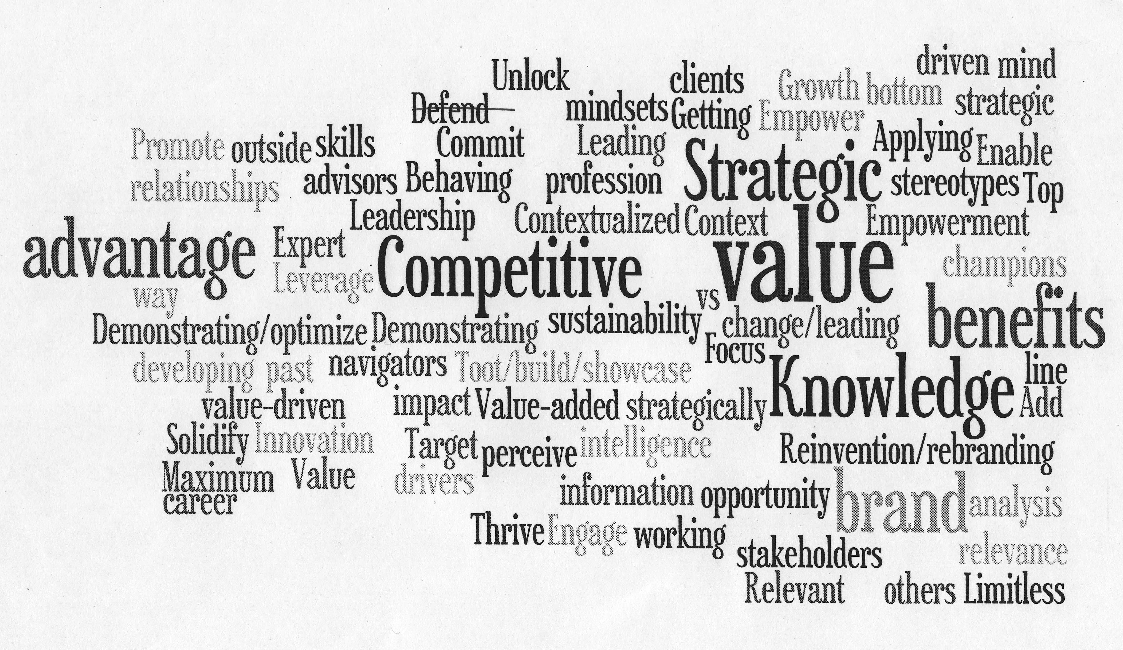
www.wordle.net/gallery
Notes:
Here is a wordle to sum up some of creating strategic value.

Slide 14

A New Strategic Agenda: Success in 2012 and Beyond
Notes:
During 2011, the SLA Board of Directors evaluated SLA’s long-term goals and objectives and at the end of the year adopted a three-year Strategic Agenda to guide its decision making for 2012-2014.
To supplement the direction of the strategic Agenda, priorities have been identified to guide the association’s leaders, volunteers, and staff toward fulfillment. Each and every SLA member has an integral role to play in order for our Agenda to become reality—a role that is professionally beneficial and that opens up new opportunities each step of the way.

Slide 15
SLA Strategic Agenda
Key Focus Areas
Annual Conference
Professional Development
Creating Richer Volunteer Experiences to Develop In-Demand Skills
Opening New Markets Through Collaboration
Growth Through Diversity
Notes:
The key areas of focus that form the SLA Strategic Agenda are:
-Annual Conference: SLA’s chief member-benefit is its highest priority. We are increasing collaboration across SLA’s divisions to provide more focused, refined content. This collaboration leverages our professional experience and institutional knowledge to ensure increased relevance of programming for SLA’s conference attendees. While increasing specificity of topics is key, the focus is on broadening opportunities for learning. SLA Past President Brent Mai established the Conferencing Task Force to look at short-term and long-term year trends in conferencing – not just library conferencing, but conferencing trends in general for today’s market. SLA’s Virtual Worlds Advisory Council is looking at opportunities for future virtual conferences.
-Professional Development: SLA’s value to its membership is enhanced not only through improved in-person development offerings, but in combination with a year-round, virtual education program. SLA and its units are providing reliable and useful professional development programming, comprising virtual opportunities throughout the year, and partnerships with schools of library and information science to co-develop content, communications, and delivery of educational programs.
Creating Richer Volunteer Experiences to Develop In-Demand Skills: A fulfilled association strategic Agenda depends heavily upon SLA’s volunteer-force—the network that gives the association its strength and relevance. What better incentive to become active in the association than the fact that it will benefit your career now and down the road? New skills picked up as volunteers in our chapters and divisions may just be the stepping stones to a promotion or recognition at work, to a new job or even a new career.
-Opening New Markets Through Collaboration: A bright future for SLA depends on collaboration with key partners within the information industry. We are striving toward an increase in opportunities available to SLA’s membership through affiliation with schools of library and information science and the vendors who provide products and services that empower SLA members.
-Growth Through Diversity: The information profession is evolving faster than ever, thanks to the rapid rate of technological change and innovation. In this evolution lies opportunity to grow SLA’s offerings to new and nontraditional sectors of the information profession, and to enhance SLA as a professional home for these groups—e.g. competitive intelligence specialists, digital asset managers, etc.
We have a new Membership Committee that is working with SLA staff and the SLA Board of Directors to grow SLA through recruiting a more diverse membership, in terms of career type and geographic location. Membership Committee members are available to help each unit’s membership chair, so please utilize them to help your unit recruit and retain members.

Slide 16
SLA Member Benefits and Opportunities
New SLA website
Annual Conference as a springboard for professional development
Volunteering at many levels to enrich/expand network and skills
Career Center
Notes:
In line with the Strategic Agenda, SLA member benefits and opportunities are many, and include:
-The new website which is a resource for us both as info pros and SLA leaders. I hope you have taken a look.
-Conference: We are transforming the annual conference from a learning and networking event—which is valuable in its own right—to a springboard for professional enrichment. The Professional Development Advisory Council and staff reviewed proposals and selected 10 CEs for the 2013 conference that would appeal to a broad audience and offer highly-relevant, practical content. In addition, CEs were vetted against regular conference sessions to minimize content overlap.
-Volunteering in a global association: We can volunteer at the unit or association level which adds to our skillset and employability. Want to expand your social media skills through real time/real life experience? Volunteer for the Online Content Advisory Council or other committees and advisory councils. There are many to choose from. SLA offers many resources and webinars to unit leaders to empower them to do their work. These resources are in the Get Involved section on the SLA website.
-Career Center: if you are looking to change jobs or need a job, be sure to upload your resume here and get alerts for jobs that are posted there. If you are looking for employees, to post your jobs here to alert fellow SLA members to job openings.

Slide 17

The SLA Strategic Agenda = Envisioning A Bright Future
Notes:
By adopting the Strategic Agenda, SLA leaders acknowledge that they are prepared and resolved to make decisions, overcome challenges, and plan forward – for the benefit of SLA members.
The Board’s adherence to this Strategic Agenda in 2012 brought about proactive and creative changes to the SLA’s Annual Conference in Chicago, and insightful, market-driven plans for succeeding annual conferences. It expanded SLA’s face-to-face and web-based continuing education offerings. As noted earlier, the new SLA website is live and the association-wide calendar shows just how much is going on for us as members.
This strategic Agenda continues to be a roadmap for our association between now and 2014 to provide the best career-enhancing benefits to our members worldwide.

Slide 18
Each time I volunteered, whether building rock walls in the West Bank or working at a school in China, I felt very much like…an idiot. Every experience was new, from the food to the language. I came to cherish my stupidity. Every time I felt dumb, I learned something.
Ken Budd. The Voluntourist: A Six-Country Tale of Love, Loss, Fatherhood, Fate, and Singing Bon Jovi in Bethlehem. 2012.
Notes:
Volunteering often isn’t for the faint of heart. Fear of making mistakes hangs over many of us, probably most of us. It prevents us from taking risks. Don’t be sidetracked by fear or fear of failure. Embrace every opportunity. Learn from failure and move on.
We ALL make mistakes and have failed.

Slide 19
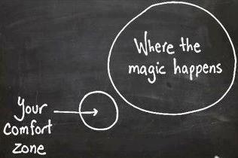
Do you want to change the world?
Chadhymas.com
Notes:
I do! At least within my sphere of influence to be a force for good. I’m passionate about what I do and what we do as a profession.
We must exert ourselves. Remaining idle without putting ourselves into action is of no use; if we remain neutral, nothing is accomplished.
Magic really does happen outside our comfort zone!

Slide 20
“Every time you are tempted to react in the same old way, ask if you want to be a prisoner of the past or a pioneer of the future.”
Deepak Chopra
Notes:
I know what I want to be. How about you?

Slide 21
Change – Love it or Hate it!
“You miss 100 percent of the shots you never take.” -Wayne Gretzky
“All great changes are preceded by chaos.”
-Deepak Chopra
“If you can dream it, you can achieve it.”
Zig Zigler
Notes:
We are indeed in a time of change.
there is no progress without change

Slide 22

Imagination Lays the Tracks for Reality to Follow

Slide 23

“Find what you love. Do what you love. Your dreams are your roadmap. Follow them to the top of the mountain. It is the most amazing view.”
Tonian Hohberg
FIDM Founder

Slide 24
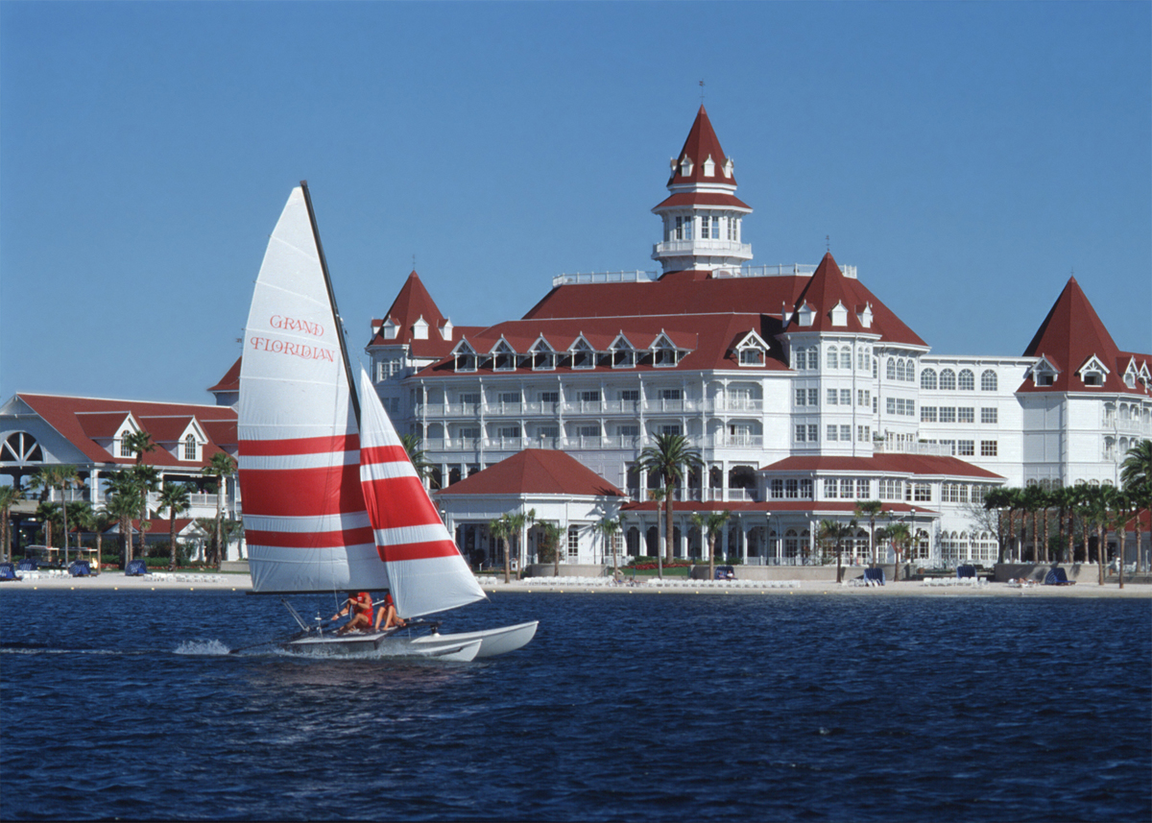
Lunch at the Beach in San Diego with Me! http://bit.ly/slabeach
Notes:
I have a fun contest to get each of us excited and on board with member recruitment and retention.
It’s Lunch at the Beach with the SLA President. We will go to Coronado Beach, named America’s Best Beach in 2012. It is also the site of the historic Del Coronado Hotel, known to locals as The Hotel Del. It was built in 1888 and has been a favorite locale of kings, queens and actors as well as a location for movies, including “Some Like it Hot” with Marilyn Monroe, Jack Lemmon and Tony Curtis.
I have family living in San Diego and have spent many vacations there over the years. My children learned to snorkel there and I learned to boogie board there. I want to share what it’s like to go to the beach, have lunch and enjoy the beautiful Pacific ocean.
I have flyers here for you if you are ready to enter the contest.

Slide 25
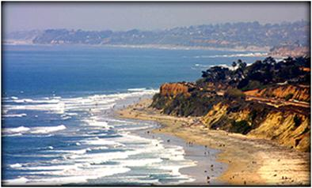
See you in San Diego!
Cue the music!
Notes:
I can’t wait to welcome you to San Diego, a beautiful part of the U.S., where there are coastal mountains, tide pools, whales and dolphins swimming offshore and endless beaches.
I hope you will plan to come to San Diego early and stay late and enjoy the California sun, and perhaps a bit of our famous coastal fog. And I hope to see you on the beach with me for lunch.
Here is a short video to get you even more excited to come to San Diego in June. http://www.youtube.com/watch?v=15SCD-yH3Yo&list=UUZw3DRL7ZkhetIIvA4BStAg&index=1

