Slide 1
Decentralizing Budget to Maximize Information Return
Mindy Beattie & Bob Kowalski, Pfizer
2013 PHT and BIO Division Spring Meeting
April 15, 2013

Slide 2
Agenda
Introductions
Why Allocation?
How We Did It
Feedback
Summary
Acknowledgements
Questions

Slide 3
Information & Library Services at Pfizer
R&D Business Technology (included in Finance Org)
Business Insights
Information & Library Services (I&LS)
Library Team
Mindy Beattie, Manager
Jane Burke, Cara Evans, Bob Kowalski

Slide 4
Pfizer in the News
Pfizer research site closure 'a major blow‘
Drug maker Pfizer is to close its research and development facility in Kent, which employs 2,400 people.
BBC News, e! Science News
1 February 2011
Pfizer slashes R&D
Drug-maker plans to cut jobs and spending as industry shies away from drug discovery.
Nature News, 9 Feb 2011
Pfizer expands its research footprint in Cambridge
MIT News
September 1, 2011
Pfizer to close historic UK site
Chemistry World (RSC) 02 February 2011

Slide 5
What Led to the Allocation Decision?
Significant reductions in budget and content every year
Pfizer R&D restructuring program announced in Feb 2011
Pipeline prioritization, cost reduction and external partners/outsourcing
IT budgets reductions each year impact available content for clients
IT interested in lowering the cost base, content did not fit the typical model of IT costs.
IT was budget holder but not primary users

Slide 6
FTE Fluctuations Since 2003
Reduced our budget by double digits

Slide 7
Options for Future Content Management
Option
Issues
Restrict usage or Cancel subscriptions
FTE’s only
Business Allocation
Reduce ability to self-serve, increase services to help others; Impacts global information
Identification and access control
No actual cost savings; business may have savings targets

Slide 8
Options for Future Content Management
Option
Issues
Reduce ability to self-serve, increase services to help others; Impacts global information
Identification and access control
No actual cost savings; business may have savings targets
In every case—we knew that the usage statistics by Division were key to the allocation.
12 months of usage needed to map appropriately
Restrict usage or Cancel subscriptions
FTE’s only
Business Allocation

Slide 9
How We Allocated the Budget
Collect
Analyze
Report
Map

Slide 10
Integrating Usage and User Divisions
Network Services
NT Username / Cost Center Info
URLs

Slide 11
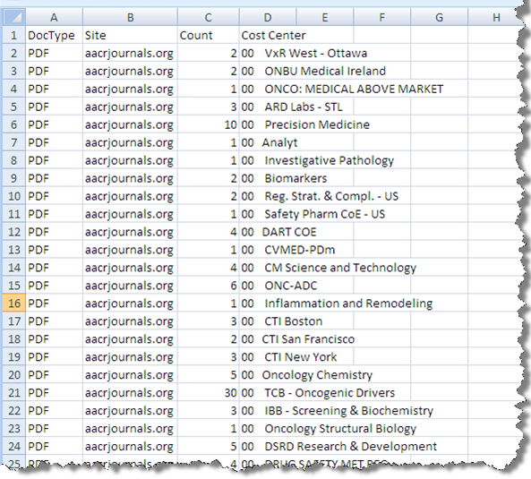
Sample Blue Coat Monthly Reporting Log

Slide 12
Pipeline Pilot / Spotfire Analysis
Supplier names
Monthly Blue Coat usage stats
Annual license fee
Content cost allocated to division based on usage statistics

Slide 13
Output in Excel: OECD Health Statistics example
Division | Usage by %
Animal Health | 12%
Human Resources | 1%
Legal | 5%
Finance | 3%
Manufacturing | 4%
Policy | 5%
Unknown Division | 3%
R&D | 35%
Commercial | 32%

Slide 14
Divisional Allocation Challenges
Majority user clearly identified
Majority user more difficult to identify
Percentage of usage attributed to company division; e.g., R&D

Slide 15
Industry Best Practices for Budget Allocation
Industry benchmarking, March-April 2012:
Survey brought results back from 12 pharma companies.
Follow up interviews with 2 companies that have well established charge back models.
Interviews with information service partners within Pfizer:
Medical Information Group
Strategic Planning
Competitive Intelligence Group
Patent Searching Group

Slide 16
Best Practices—Findings
Challenges identified from other pharma companies
Budget allocation can only be estimated based upon the previous one year of actual usage.
A Stakeholder Council should be in place.
Selective licensing is not an option for Enterprise Licenses with IP authentication.
Risks/Issues – partner feedback
Many of our users are service providers themselves so this may cause a domino-effect of cross charging behavior.
Some eContent products are currently funded by other lines who share use across the enterprise

Slide 17
Allocation Models Proposed to IT Leadership
Model Proposed | % of Budget Retained in Library
“Phone Bill” | 10%
Greater than 50% or more usage mapped to Division | 32%
Greater than 35% or more usage mapped to Division | 9%

Slide 18
Allocation Models Proposed to IT Leadership
Model Proposed | % of Budget Retained in Library
“Phone Bill” | 10%
Greater than 50% or more usage mapped to Division | 32%
Greater than 35% or more usage mapped to Division | 9%
Model Proposed | % of Budget Retained in Library
“Phone Bill” | 10%
Greater than 50% or more usage mapped to Division | 32%
Greater than 35% or more usage mapped to Division | 9%

Slide 19
Output in Excel: OECD Health Statistics example
Division | Usage by %
Animal Health | 12%
Human Resources | 1%
Legal | 5%
Finance | 3%
Manufacturing | 4%
Policy | 5%
Unknown Division | 3%
R&D | 35%
Commercial | 32%

Slide 20
Partnering with the Business

Slide 21
Communication with Stakeholders
Met with three stakeholders to review
Renewals process with high level milestones including approvals
Previous years’ key licenses and their terms
Results of current usage statistics and future needs analysis
Negotiation strategy
Communication plan

Slide 22
Renewals Process with Stakeholders
Kickoff in September to review high value licenses
Established weekly updates
Emailed status updates and I&LS recommendations for renewals (pre-read)
Met with stakeholders to give recommendations and seek approval
Maintained spreadsheet with current and prior year license fees; track variance

Slide 23
What Went Well
Content retention
Greater percentage of content retained (budget still tight but avoided across the board reduction)
Seat at the table
Regular meetings with R&D Leadership = higher visibility for our services, resources and department
Process Improvements
“By freeing the eContent budget, our librarians are now recognized by senior R&D leaders as playing a key role in maximizing our information assets”
Joanna Woodward, Director, Information & Library Services

Slide 24

I&LS Negotiators—Feedback
 | Activity | Feedback/Proposed Solution
 | Multiyear agreements | Process 2014 renewals earlier; propose multiyear with remaining publishers when appropriate
 | Communication between I&LS and R&D Team | Expedited signature process and Procurement approvals
 | Engagement and guidance from R&D supported the I&LS team | Suppliers receptive when I&LS communicated R&D’s expectations
 | I&LS Director signed agreements | Fewer agreements to route through R&D

Slide 25
I&LS Negotiators—Feedback
 | Activity | Feedback/Proposed Solution
 | Inconsistencies in data presented in email status updates | Negotiators will propose a standard for presenting information; will request feedback from R&D on data points
 | Simplify talking points during status update meetings | Provide clear and concise information to maximize R&D’s staff time
 | All licenses not completed by expiration | More multiyear agreements; prioritize those that had lengthy negotiation in 2012—schedule meetings with suppliers earlier

Slide 26
Timeline for Collection & Implementation
Present final allocation options to IT exec leaders
Present to executive business stakeholders
Communicate to Pfizer colleagues about canceled content
Initiate tracking with Blue Coat system; analyze usage
Present allocation options to departmental and IT exec leaders
Met with stakeholders to explain governance process
Present content options and recommendations to Dept Leaders and then IT exec leaders
2/11 – 6/11
7/11
12/11
3/12
8/12
8/12
9/12

Slide 27
Summary
Usage statistics and analysis are key
Plan sufficient time for analysis, mapping and meetings with leadership and stakeholders
Buy-in from stakeholders and leadership critical
Expect to manage multiple budgets with different approval processes
Align with the business strategy
R&D sponsoring program to maximize information assets

Slide 28
Acknowledgements
Jane Burke: Librarian
Cara Evans: Library Systems Manager
Tracy Gregory: Data Analysis and Visualization
Carla Hernandez: Data Analysis and Visualization
Patty McIntire: Data Analysis
Jon Meek: Data Collection
Jo Woodward: Project Sponsor
Additional Pfizer colleagues in Finance; Competitive Intelligence; Medical Information; Patent Searching & Information; Procurement

Slide 29
Questions

